Slide 1
Notes to Parents
Buddy the Dog’s Internet Safety Story can be used to teach young children how to use the Internet safely in a fun way! The story specifically focuses on the safe use of tablets and smartphones.
As you read the story, you may like to ask your children their opinions on what Ben should do in each scenario. This will help to initiate discussions about key online safety issues.
A catchy song is also included within the story to reinforce the key Internet Safety messages.
You may wish to delete this slide before beginning the presentation.

Slide 3
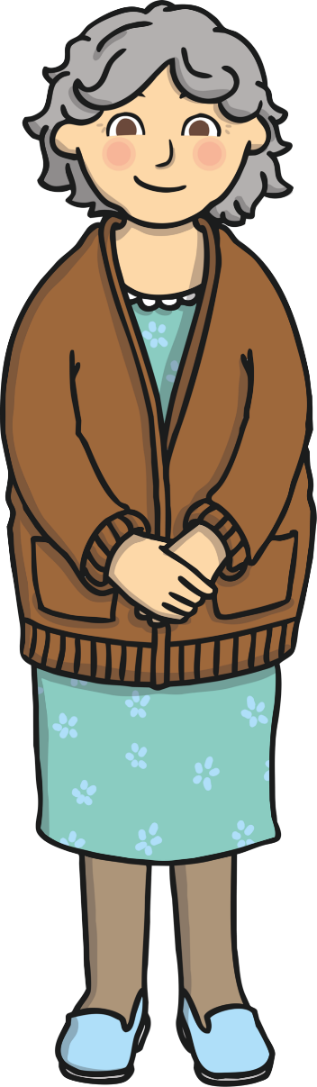
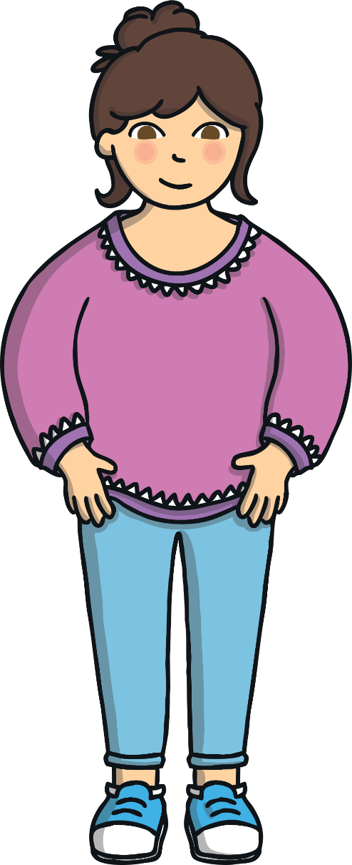
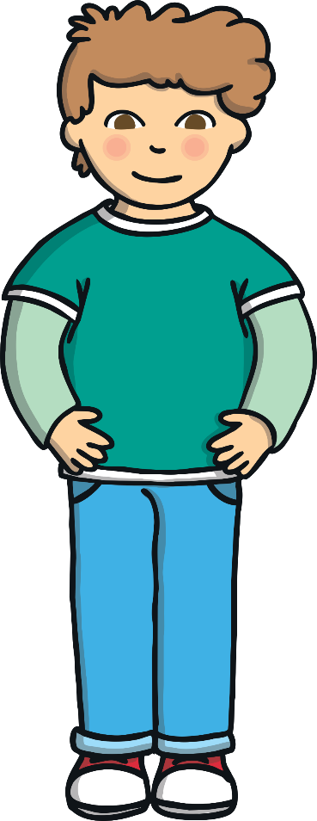
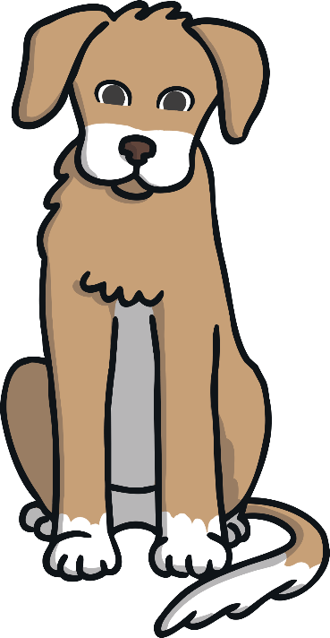
Characters
Ben
Buddy
Grandma
Mummy
There are 4 characters in this exciting story!

Slide 4
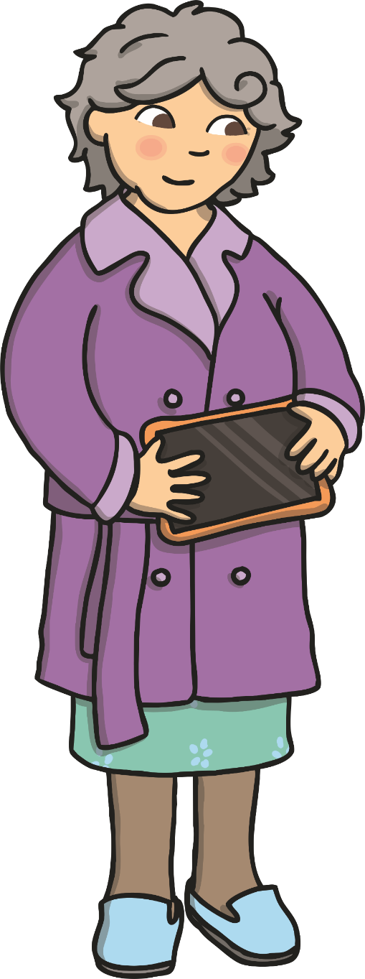
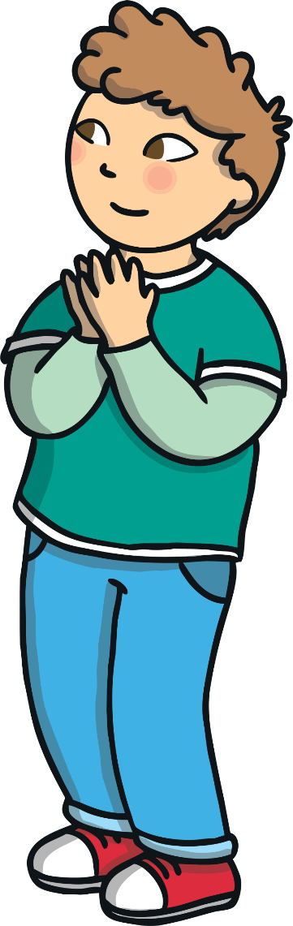

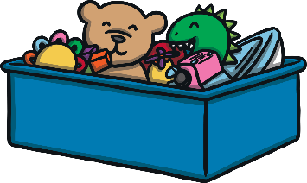

One day, Ben’s Grandma came home from the shops looking very excited and gave Ben a tablet. She told Ben that she saw the tablet on sale, she had no idea what it did, but she knew that Ben had been asking for one for ages!

Slide 5
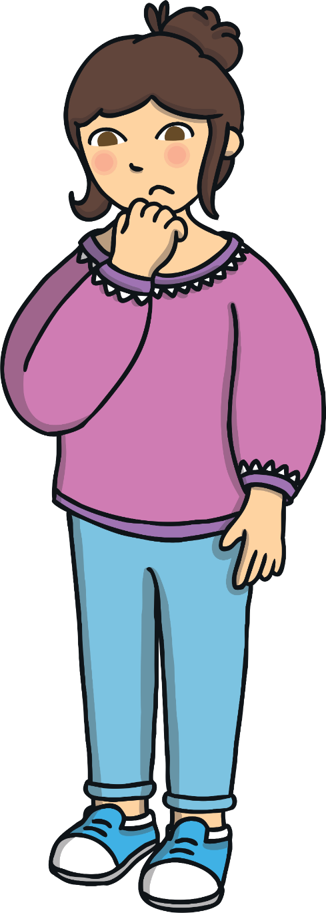

When Ben’s Mummy saw the
tablet, she was a little bit worried because you can use the Internet on it. She thought Ben was too young to know how to use the Internet safely.
Mummy made Ben promise that if he was ever unsure what to do with his tablet he would ask for help straight away!
Ben promised his Mummy that he was grown-up enough to use the tablet safely.
I’m worried you are too young for a tablet!
I promise I will use the tablet safely, Mummy!

Slide 6
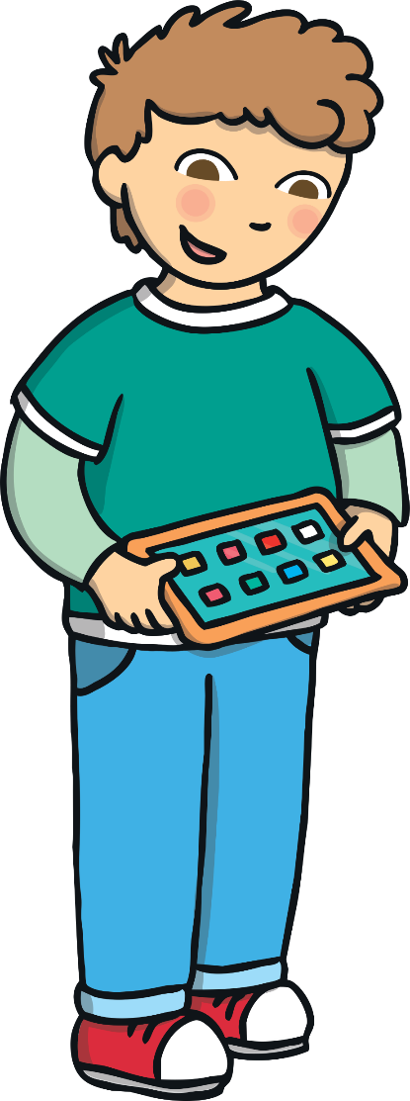
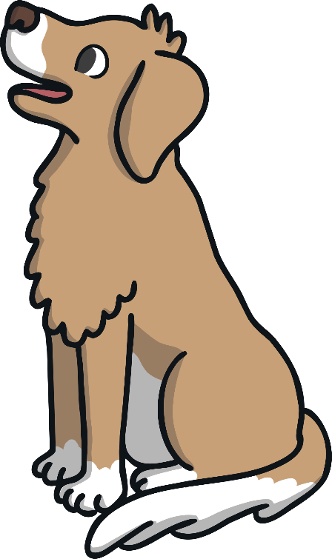
Ben’s Mummy installed lots of child-friendly apps on to the tablet. She downloaded lots of fun games for Ben to play and told him he could only go on apps on his tablet that she had looked at first.
Ben’s Mummy asked Buddy the dog if he would help to make sure Ben used his new tablet safely. Buddy barked very loudly to tell Mummy that he would!
Will you help Ben to use his tablet safely?
Woof, woof
woof!

Slide 7
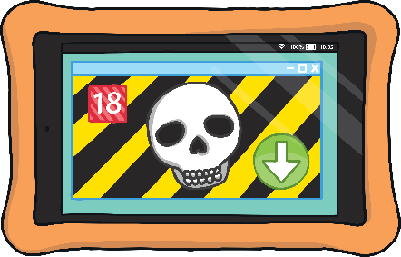
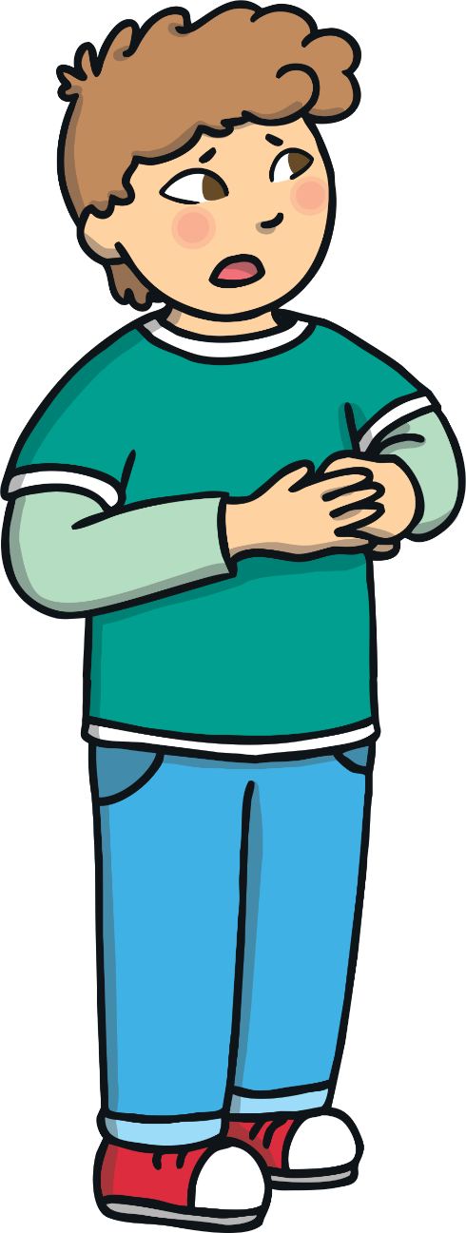
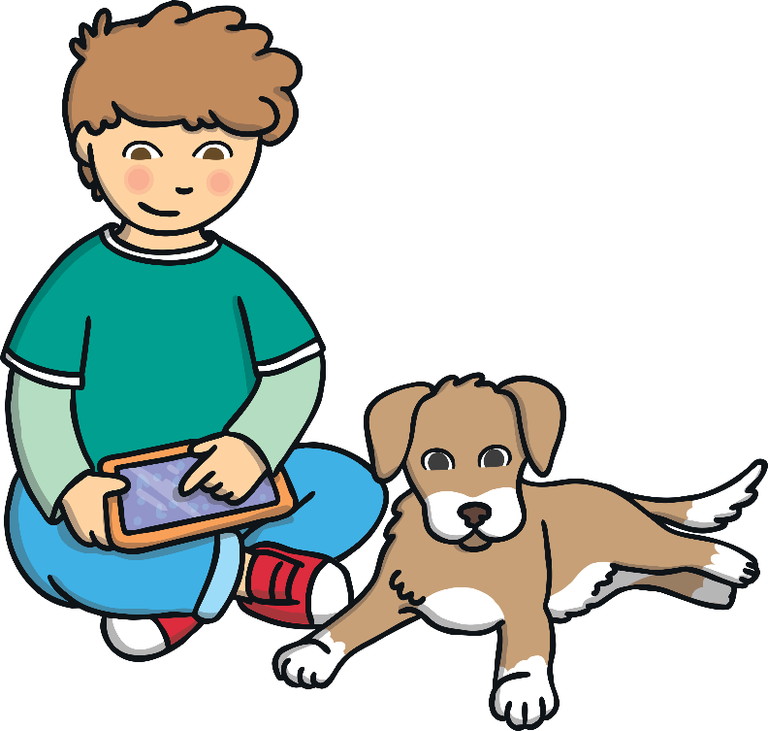
Ben had lots of fun playing on his tablet until suddenly, an advert for a new game appeared.
There was an arrow that Ben could press to download the new game.
Ben had never seen the game before but he thought it looked very exciting! He asked Buddy, “Do you think I should press the arrow to download the new game?”
Do you think I should press the arrow to download the new game?

Slide 8





Buddy helped Ben to decide what to do by singing his helpful ‘Use Your Tablet Safely’ song!
Buddy’s ‘Use Your Tablet Safely’ Song
(Sung to the tune of Frère Jacques)
Ask your grown-up,
Ask your grown-up,
Ask for help!
Ask for help!
Use your tablet safely,
Use your tablet safely,
Woof, woof, woof!
Woof, woof, woof!

Slide 9
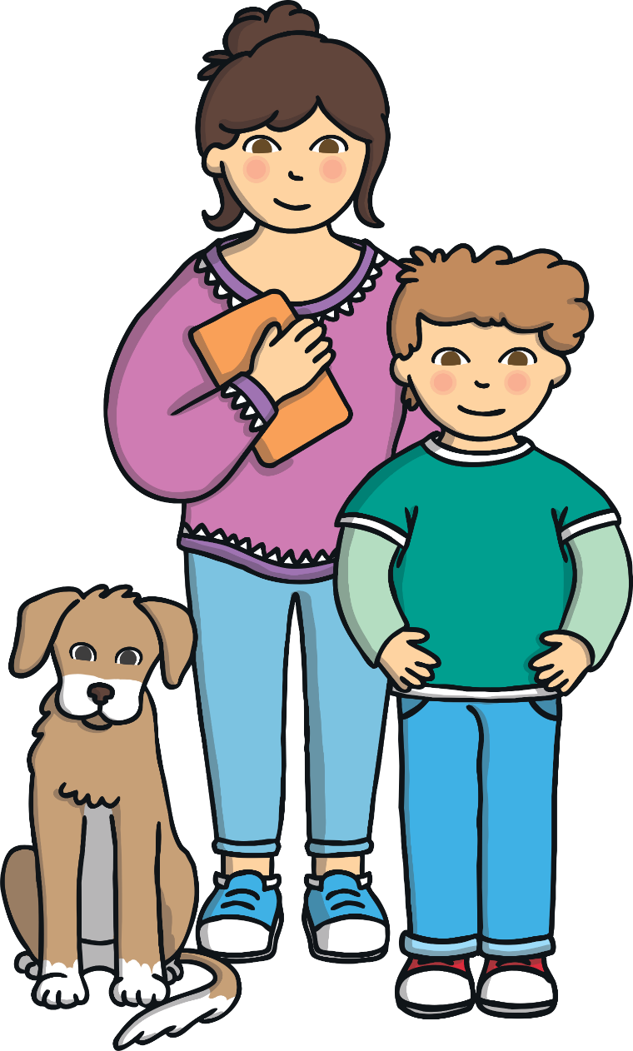
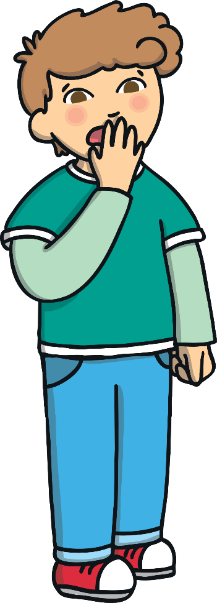

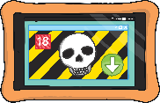
Ben listened to Buddy’s song and did the right thing, he shouted out, “Mummy, Mummy, I need your help!”
Ben’s Mummy came quickly and looked at Ben’s tablet. She told Ben that the advert was for a game for older children and that it would be too tricky for Ben.
She said well done to Ben for calling for help when he wasn’t sure what
to do. She downloaded a new game for him, which he had lots of fun playing on.
Mummy, Mummy, I need your help!
Good boy Ben, you did the right thing asking for help!

Slide 10
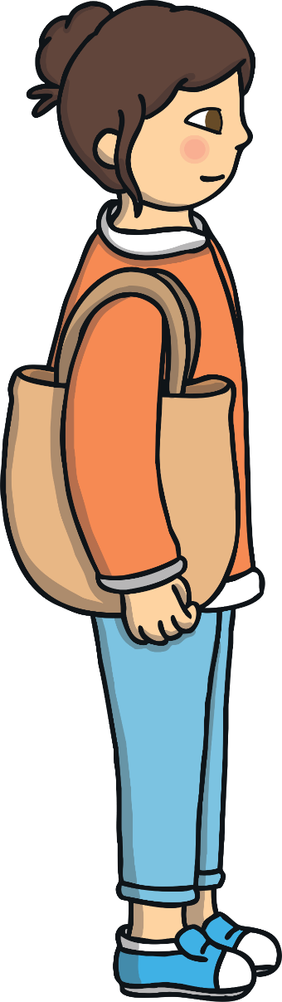
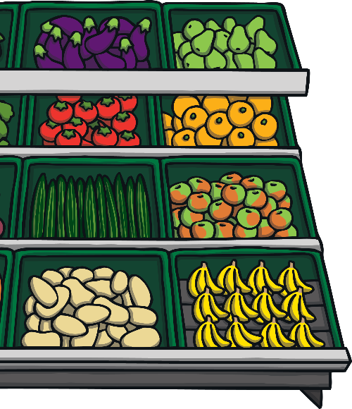
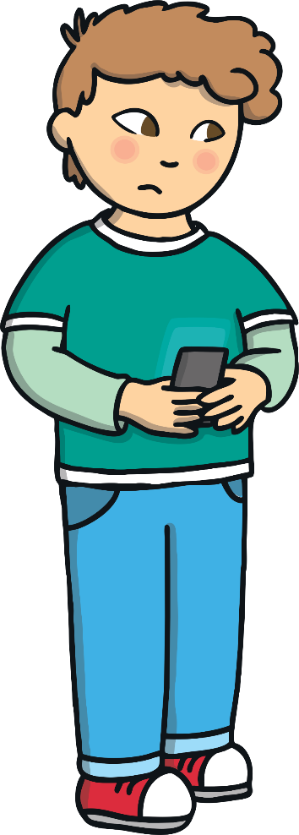

The next day, Ben and his Mummy went shopping together.
Mummy told Ben that because he had been so sensible using his tablet, he could watch a video on her phone while she was shopping.
Ben accidentally pressed something on the phone and a different video appeared on the screen. Ben didn’t know if he should watch the video and Buddy wasn’t there to help him.
He wondered,
“Should I watch this video, even though I don’t know what it is?”
Should I watch this video, even though I don’t know what it is?

Slide 11

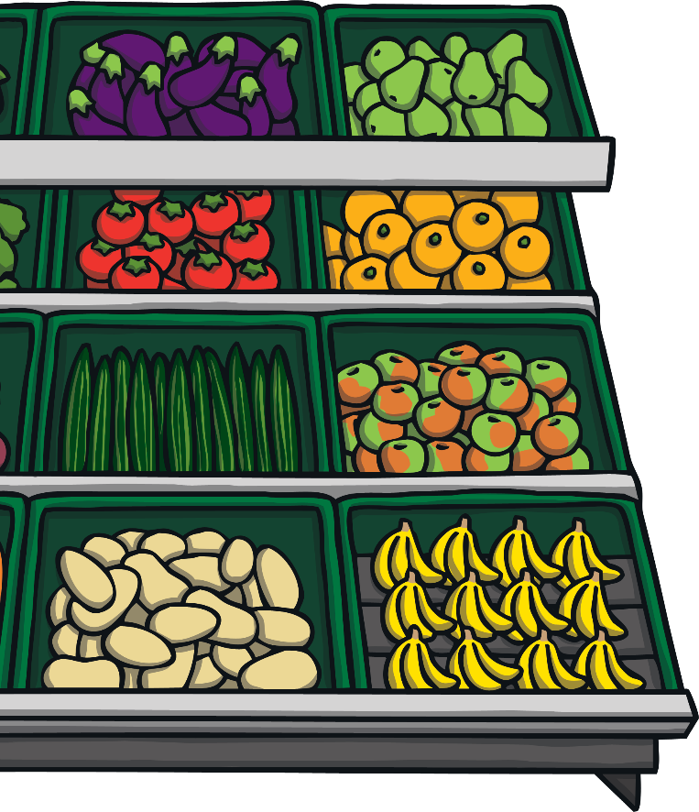

Ben remembered what Buddy’s song said to do,
‘Ask your grown-up,
Ask your grown-up,
Ask for help!
Ask for help!’
Ben shouted out, “Mummy, Mummy, I need your help!”
Mummy quickly came and looked at her phone. She told Ben that on the Internet there are some videos that are not suitable for children, just like some TV shows and films on the television.
She told Ben he was very clever asking for help and for not watching a video when he didn’t know what it was.

Slide 12


Later that night, Ben was having lots of fun playing a game online against one of his friends from school.
Suddenly a message from someone Ben didn’t know appeared on the screen. It said “Hello, can I play too?”
Ben was shocked and didn’t know what to do. He didn’t know this person but he didn’t want to be unkind and say they couldn’t play the game.
Just as Ben was about to message the person back to say they could play too, Buddy started barking!
Ben asked Buddy, “Do you think I should let this person join in my game?”
Hello, can I
play too?

Slide 13
Buddy helped Ben to decide what to do by singing his helpful ‘Use Your Tablet Safely’ song!
Buddy’s ‘Use Your Tablet Safely’ Song
(Sung to the tune of Frère Jacques)
Ask your grown-up,
Ask your grown-up,
Ask for help!
Ask for help!
Use your tablet safely,
Use your tablet safely,
Woof, woof, woof!
Woof, woof, woof!

Slide 14
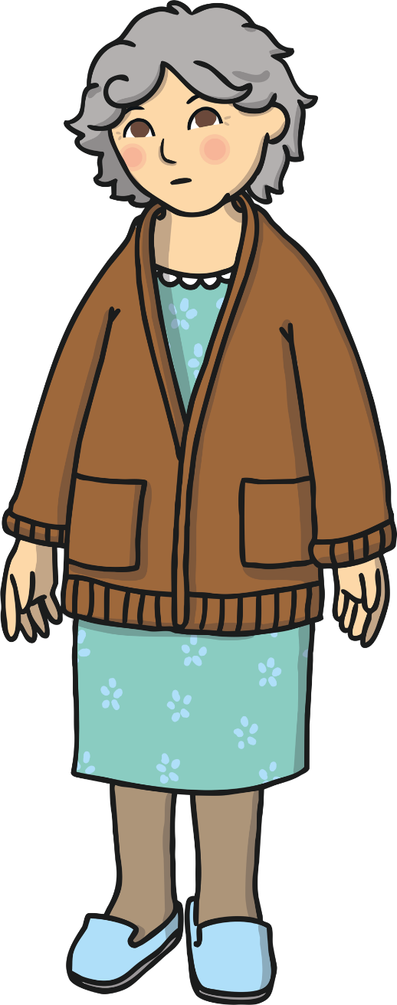

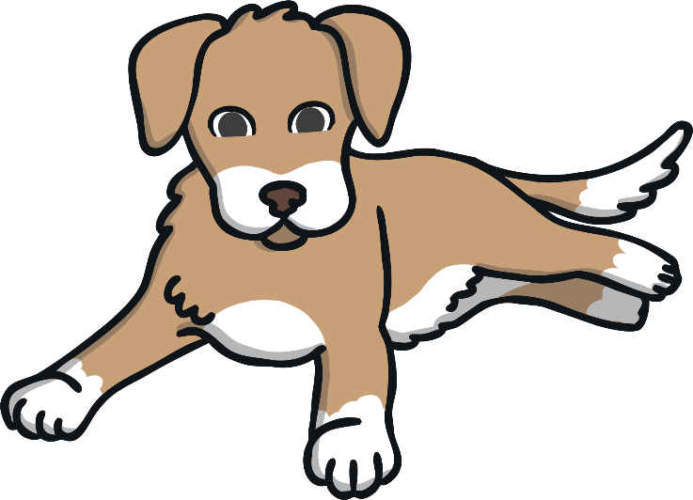
Ben listened to Buddy’s song and did the right thing.
He shouted, “Mummy, Mummy, I need your help!”
This time Grandma came to see Ben because his Mummy was busy. She asked if she could help him.
Ben told his Grandma that he was unsure if he should reply to the person he doesn’t know.
Grandma asked Ben, “If you were playing in the park and a stranger asked you to play a game with them, would you?”
Would you play a game with an adult stranger in the park?

Slide 15



Ben looked shocked and told his Grandma that you should never talk to strangers!
Ben’s Grandma told him that it was the same on the Internet.
“If you don’t know the person who is asking to play, you shouldn’t talk to them.” said Grandma.
Ben tells his Grandma that he thinks she is right and he should only talk to people on the Internet that he knows. He shouldn’t talk to strangers online.
Grandma asks Ben if he will show
her how to use the Internet safely on his tablet as she has no idea what to do!
I should only talk to people online that I know, not strangers!
Only message and play games with people that you know on the internet

Slide 16
Ben helps to teach his Nanny how to use the Internet safely. He teaches her some important Internet safety rules!
Internet Safety Rules
Always ask a grown-up for help if you see anything strange or unusual.
Don’t download or install anything without asking a grown-up first.
Remember, not all games and videos are for children.
Don’t talk to strangers online and don’t tell them where you live.
If you are ever unsure what to do, remember
Buddy’s song, and always ask for help!

Slide 17
Buddy helped Ben to decide what to do by singing his helpful ‘Use Your Tablet Safely’ song!
Buddy’s ‘Use Your Tablet Safely’ Song
(Sung to the tune of Frère Jacques)
Ask your grown-up,
Ask your grown-up,
Ask for help!
Ask for help!
Use your tablet safely,
Use your tablet safely,
Woof, woof, woof!
Woof, woof, woof!

