Slide 2
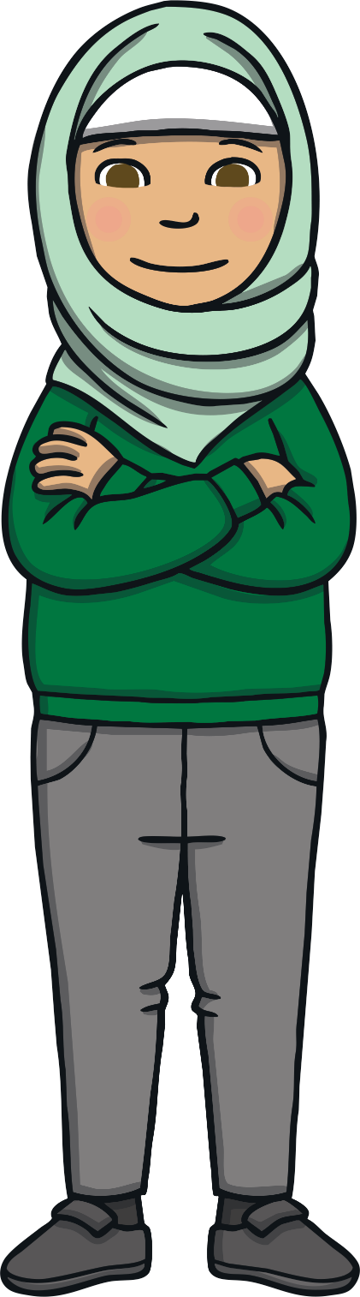
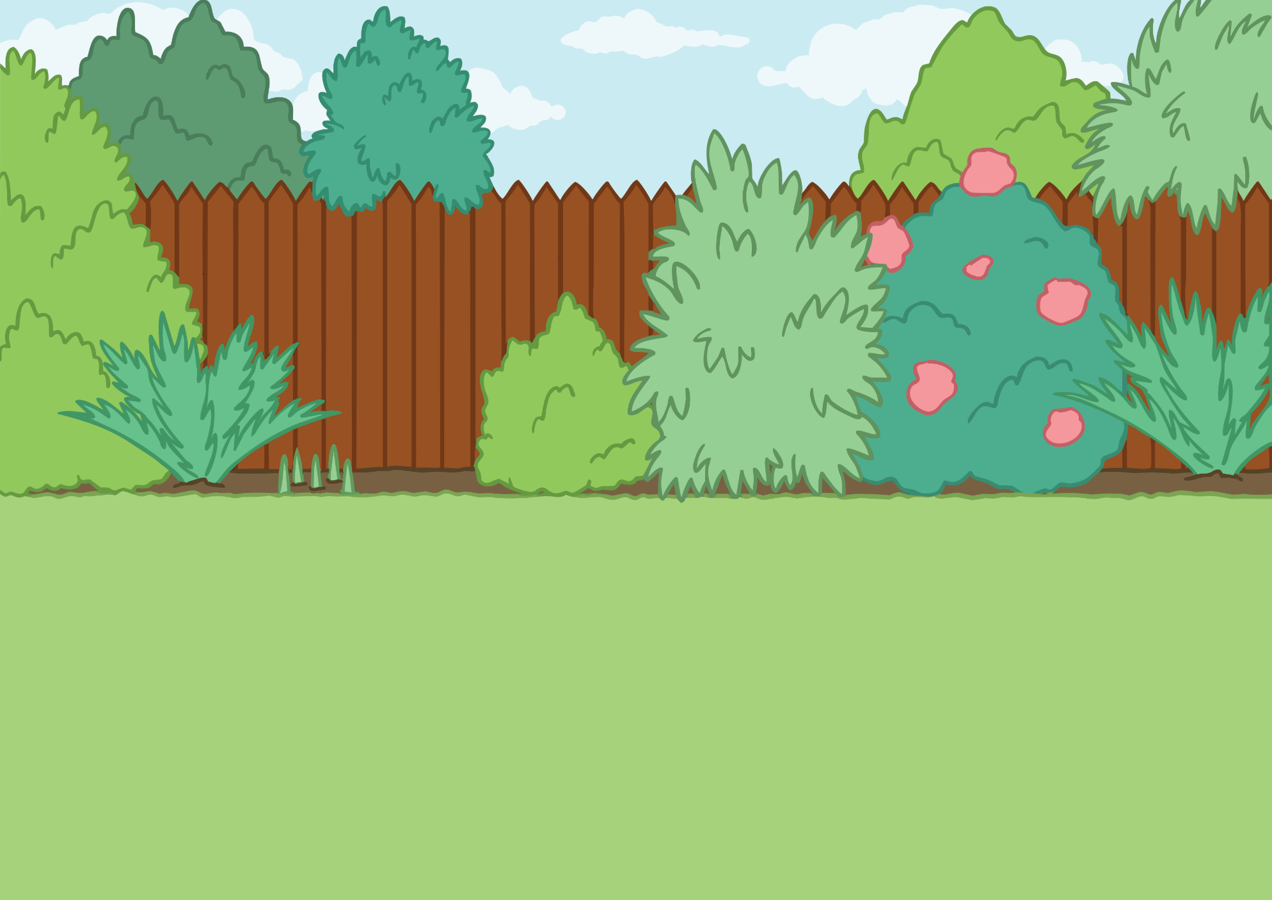
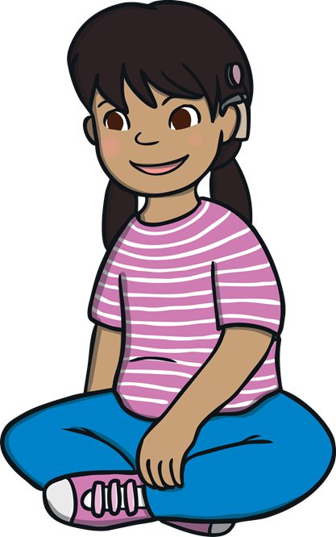
My body is my own.
I look after it well.

Slide 3
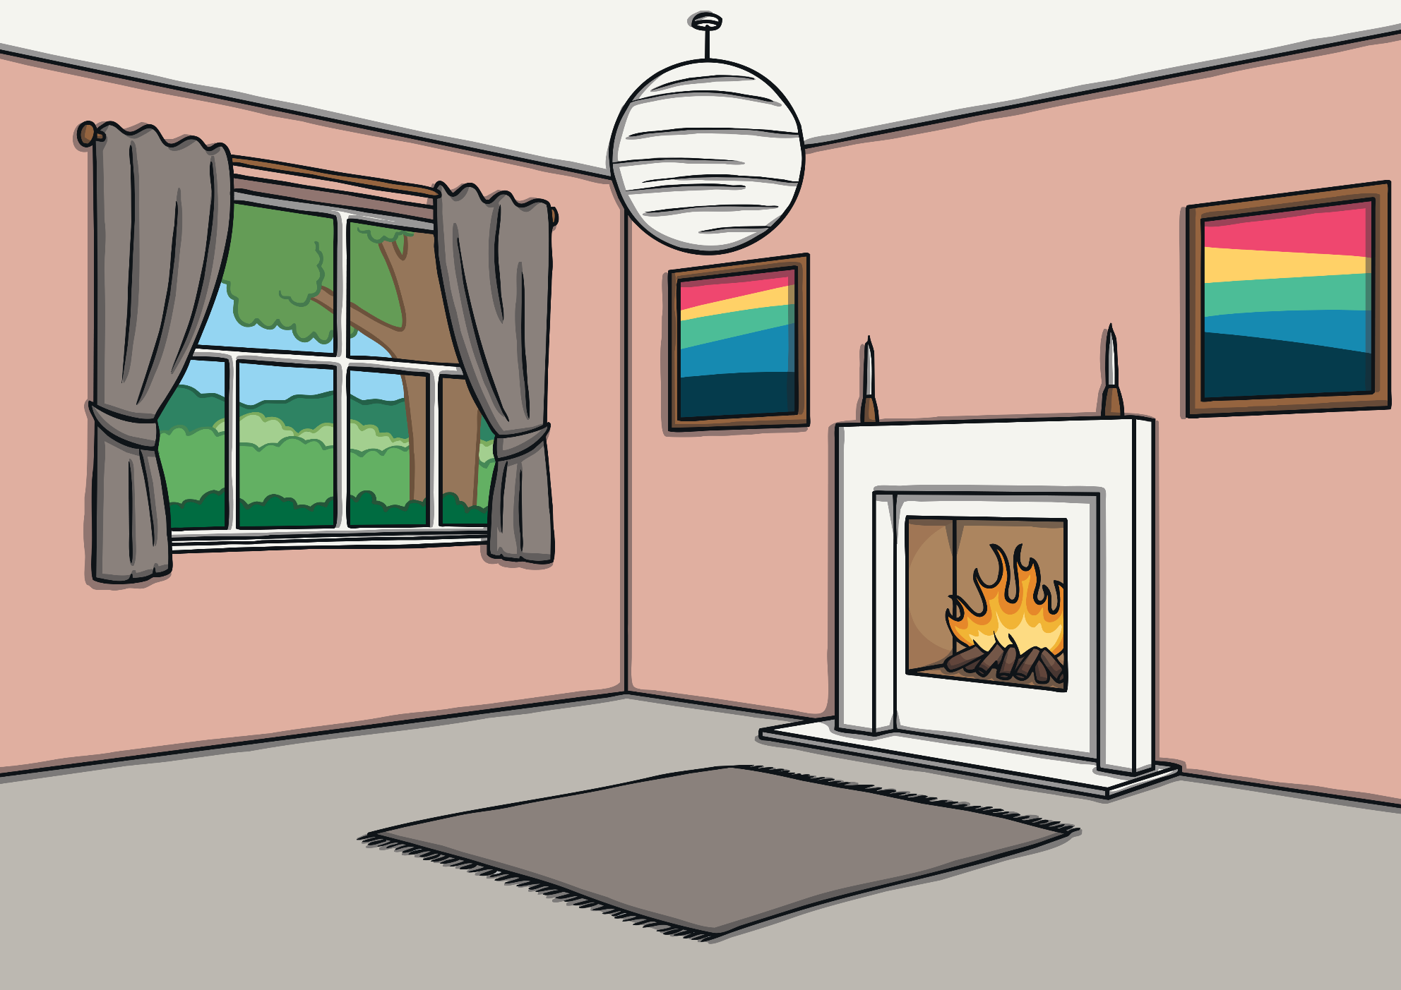
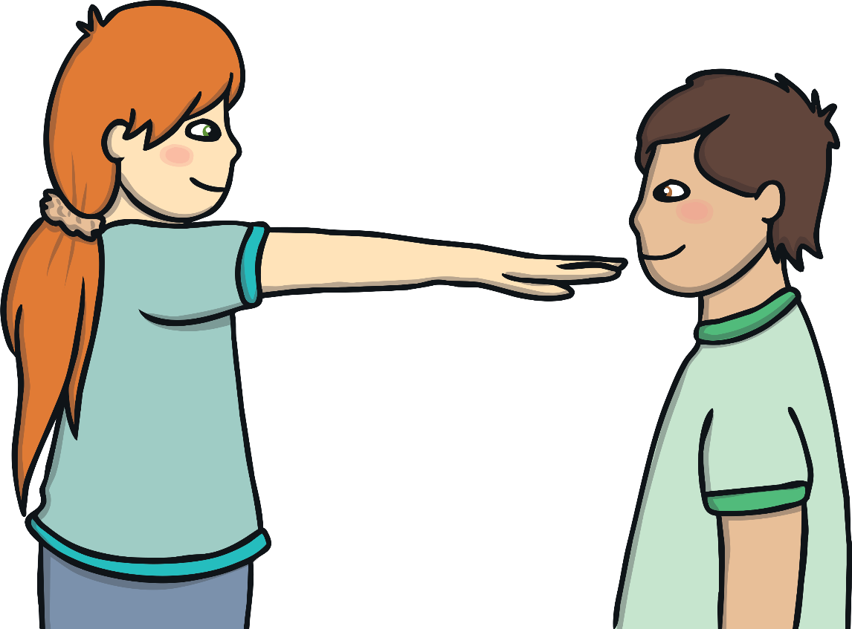
Everybody has personal space.
This is space around our body that we only
let some people into at certain times.
We respect other people’s personal space.

Slide 4
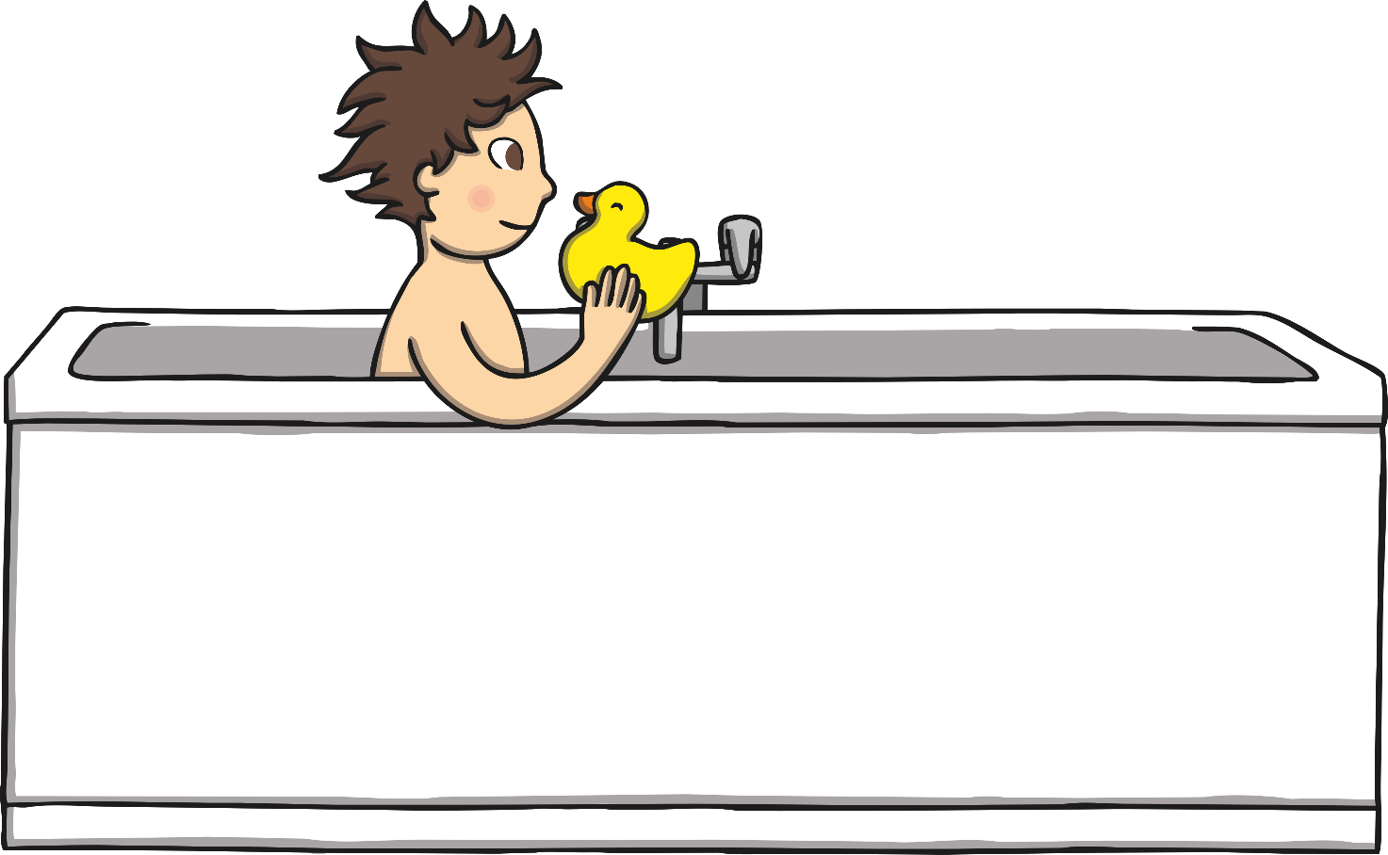
My body belongs to me.
It is my responsibility to keep my body clean
and fresh.
When I take a bath or a shower, I close
the door.
I wash with warm water and soap.

Slide 5
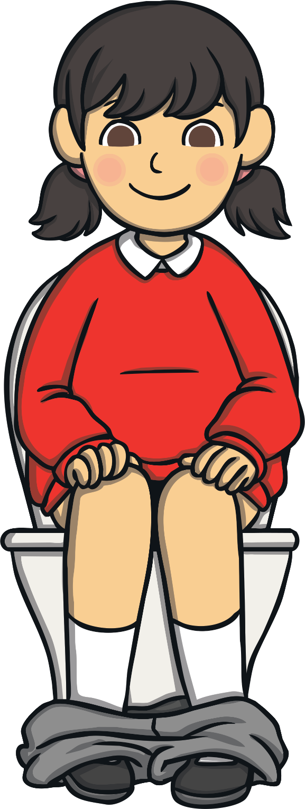

I know when I need to go to the toilet.
I flush the toilet when I am finished.
I wash my hands when I am done.

Slide 6
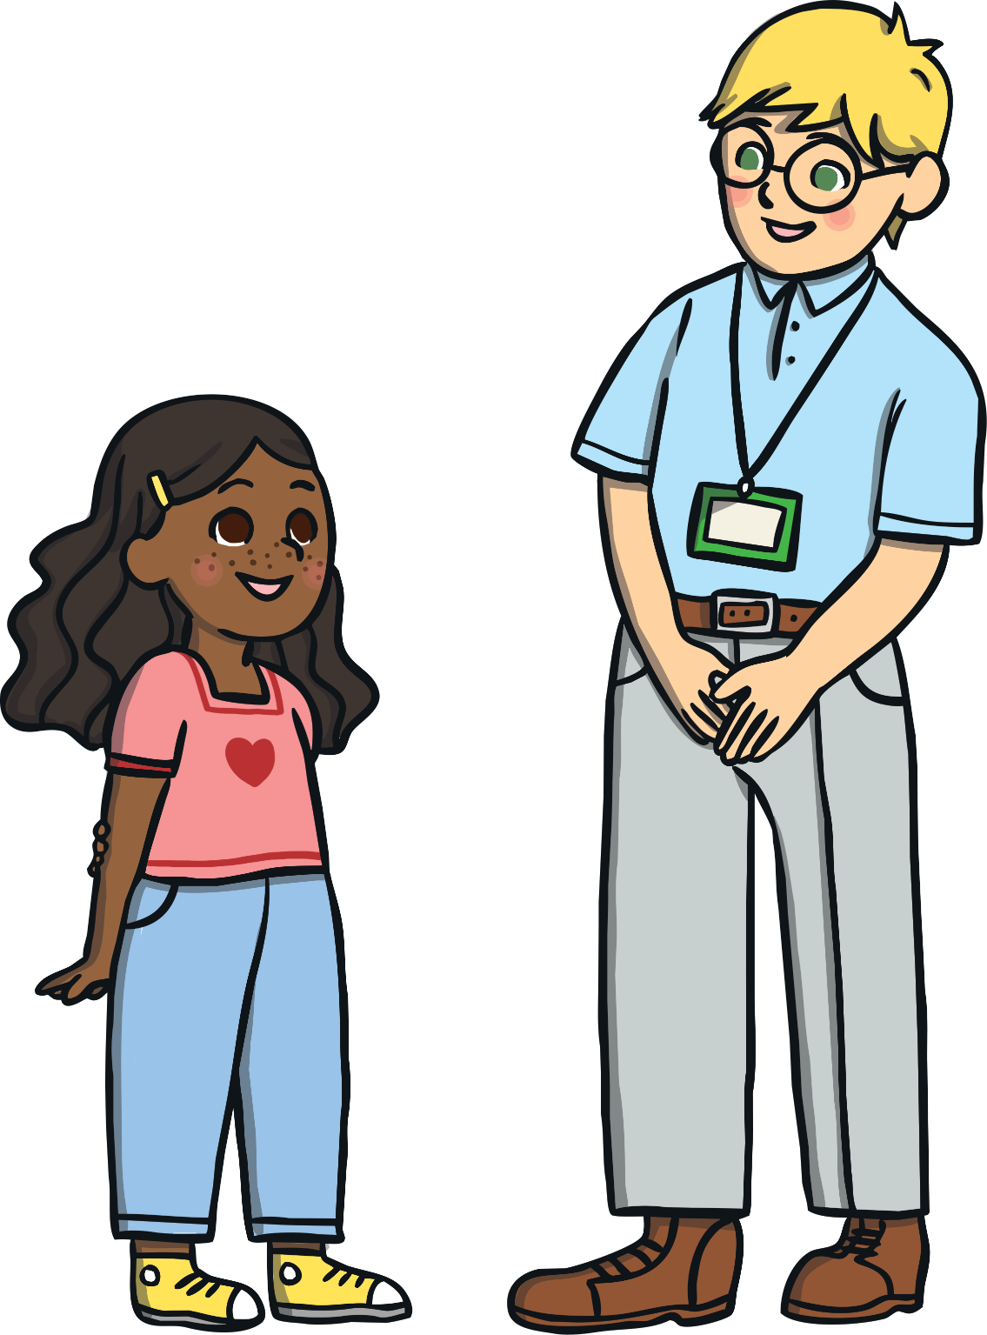
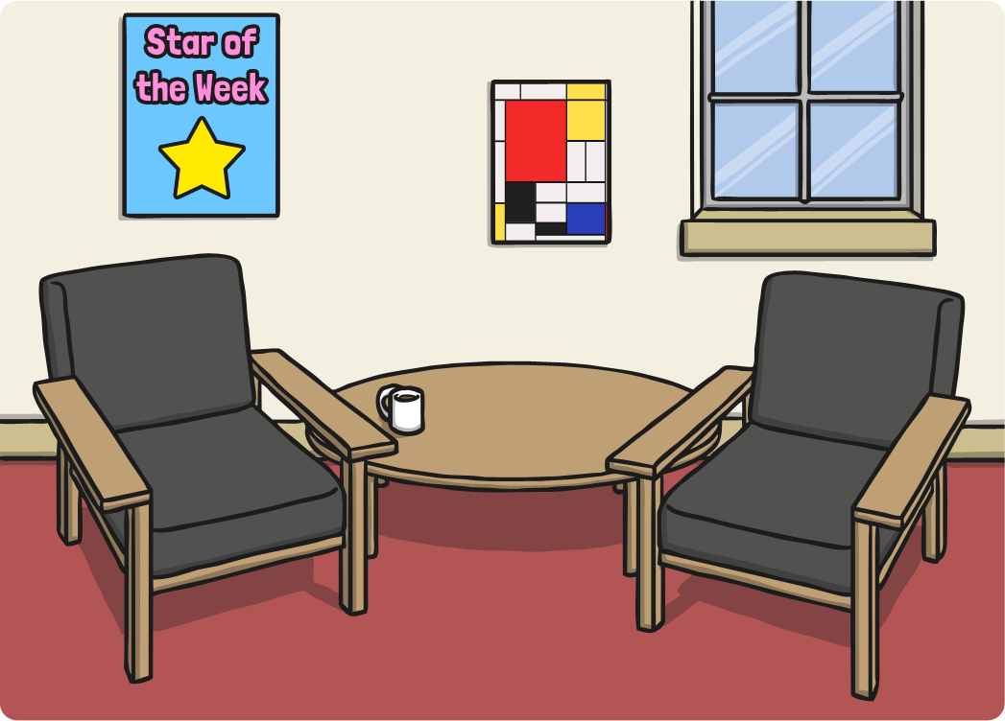
If I need help with anything, I can ask an
adult I trust.

Slide 7
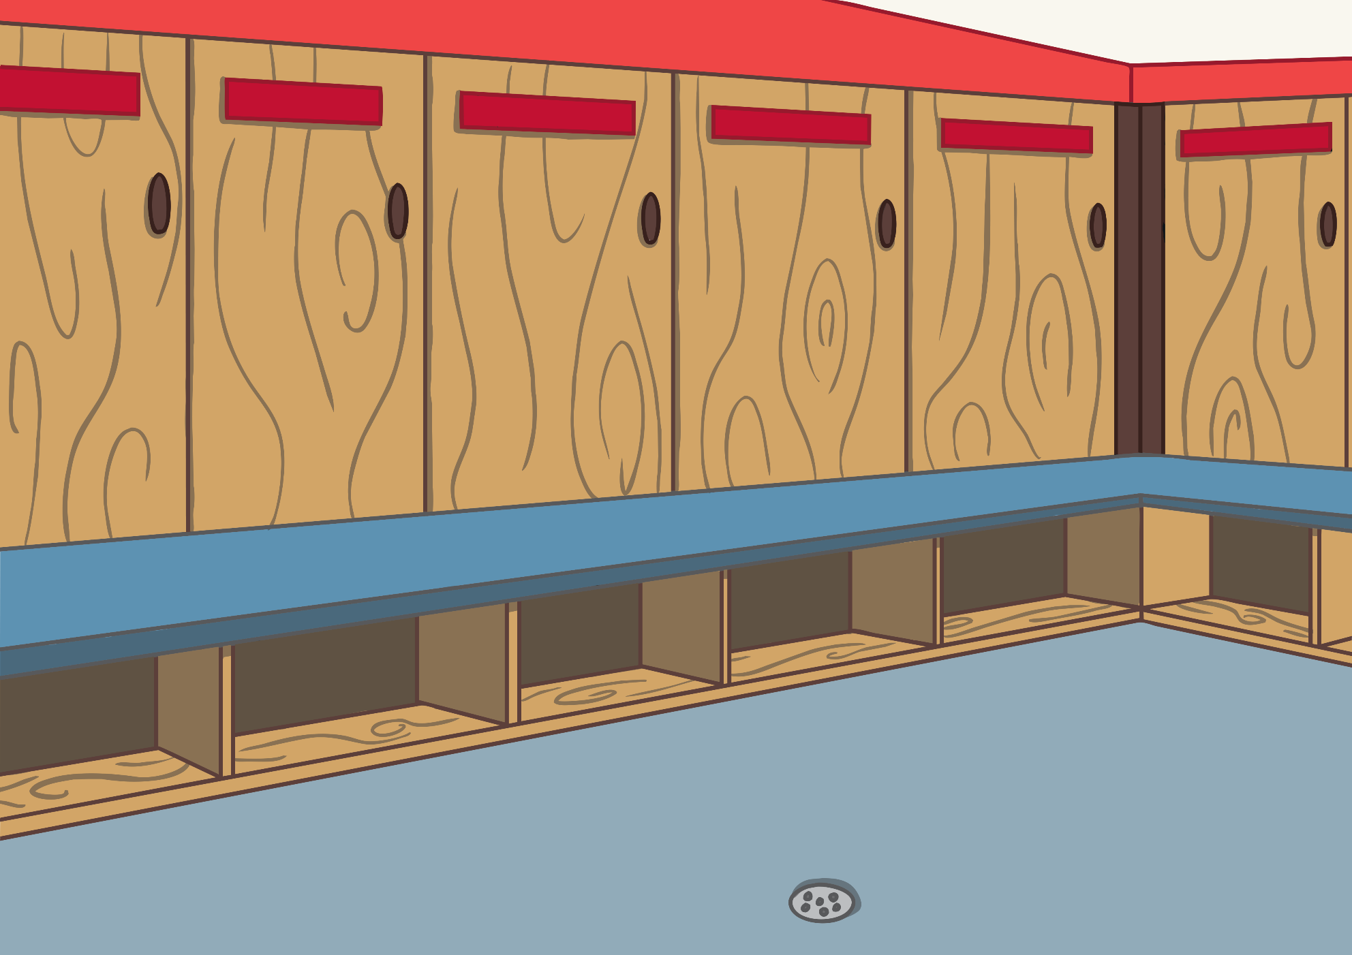
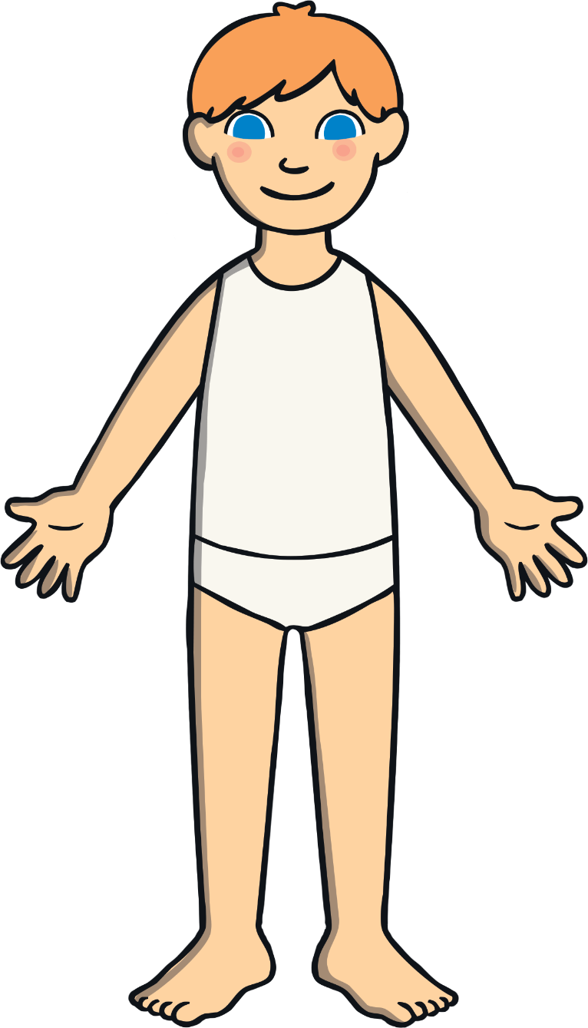
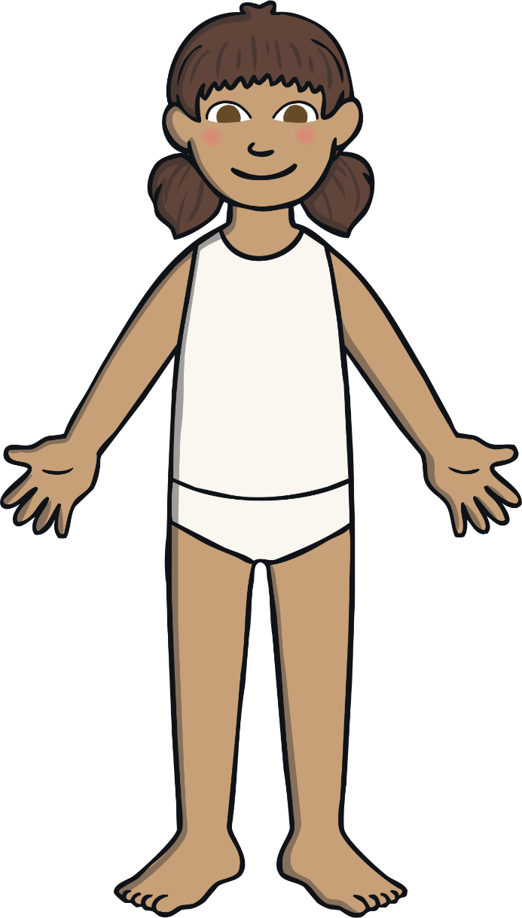
My private parts are the areas that are
covered by my underwear.
My private parts should stay covered unless I
am changing, washing or going to the toilet.

Slide 8

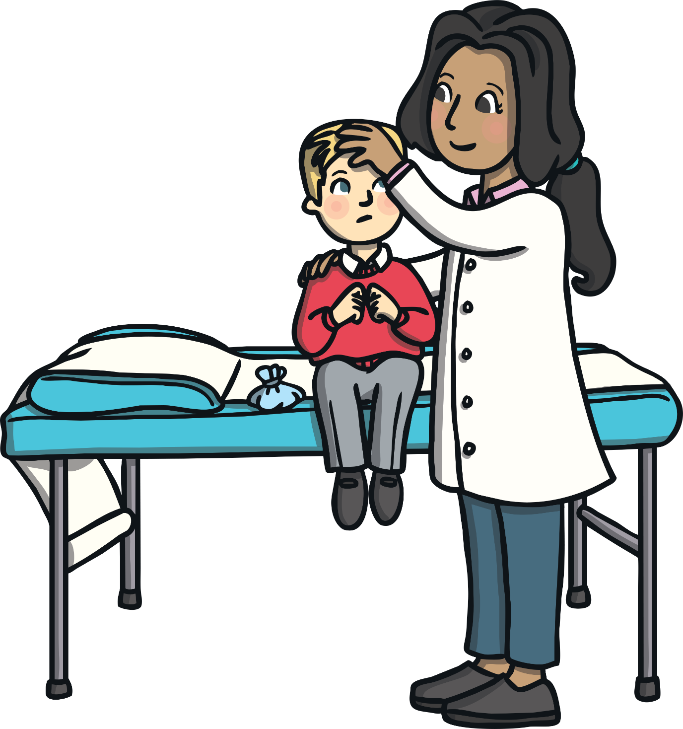
Sometimes, a doctor may want to see my
private parts if I need help.
If I do not want someone to do this, I must
say ‘No’.

Slide 9
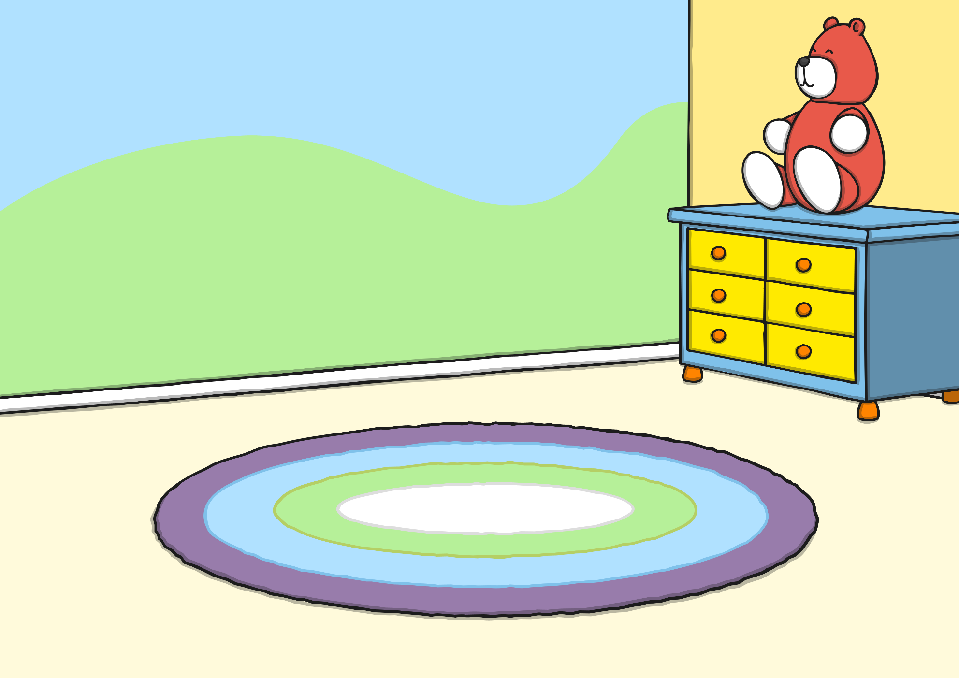
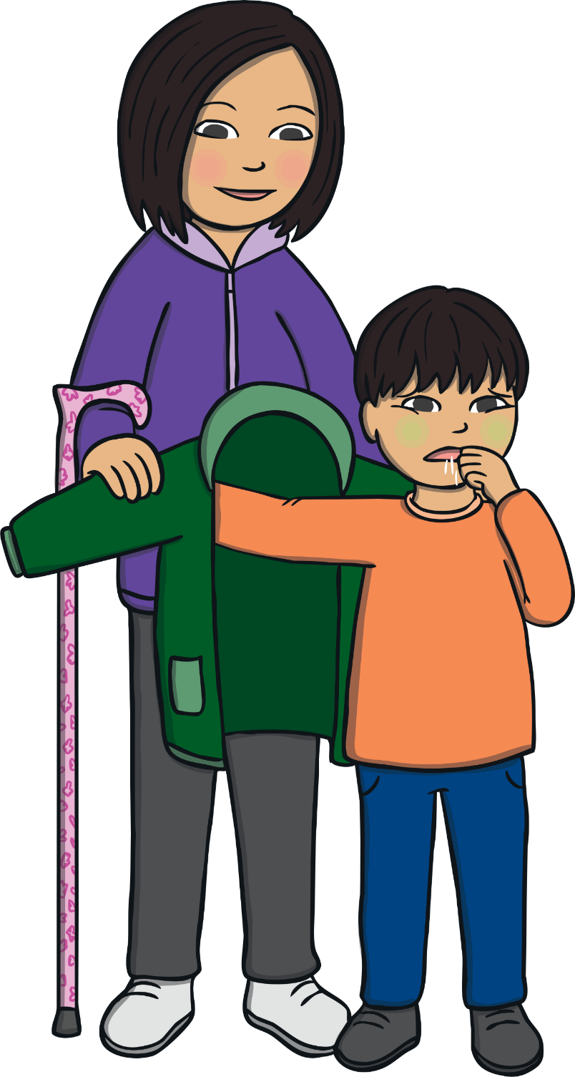
Members of my family may help me to get
washed and dressed, so they might see my
private parts.
If I do not want them to do this, I can
always say, ‘No’.

Slide 10
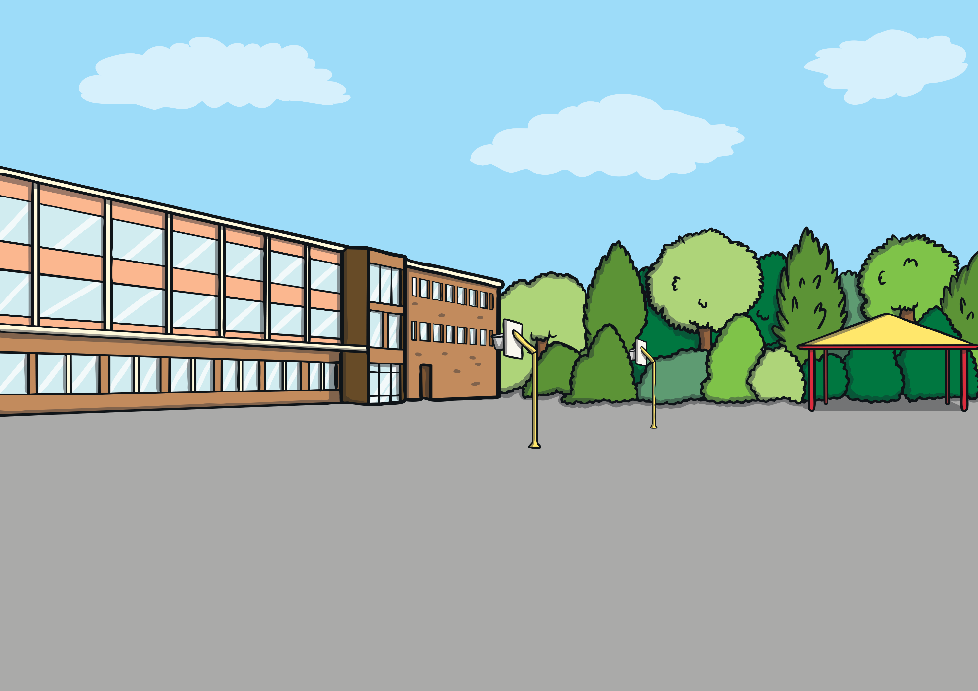
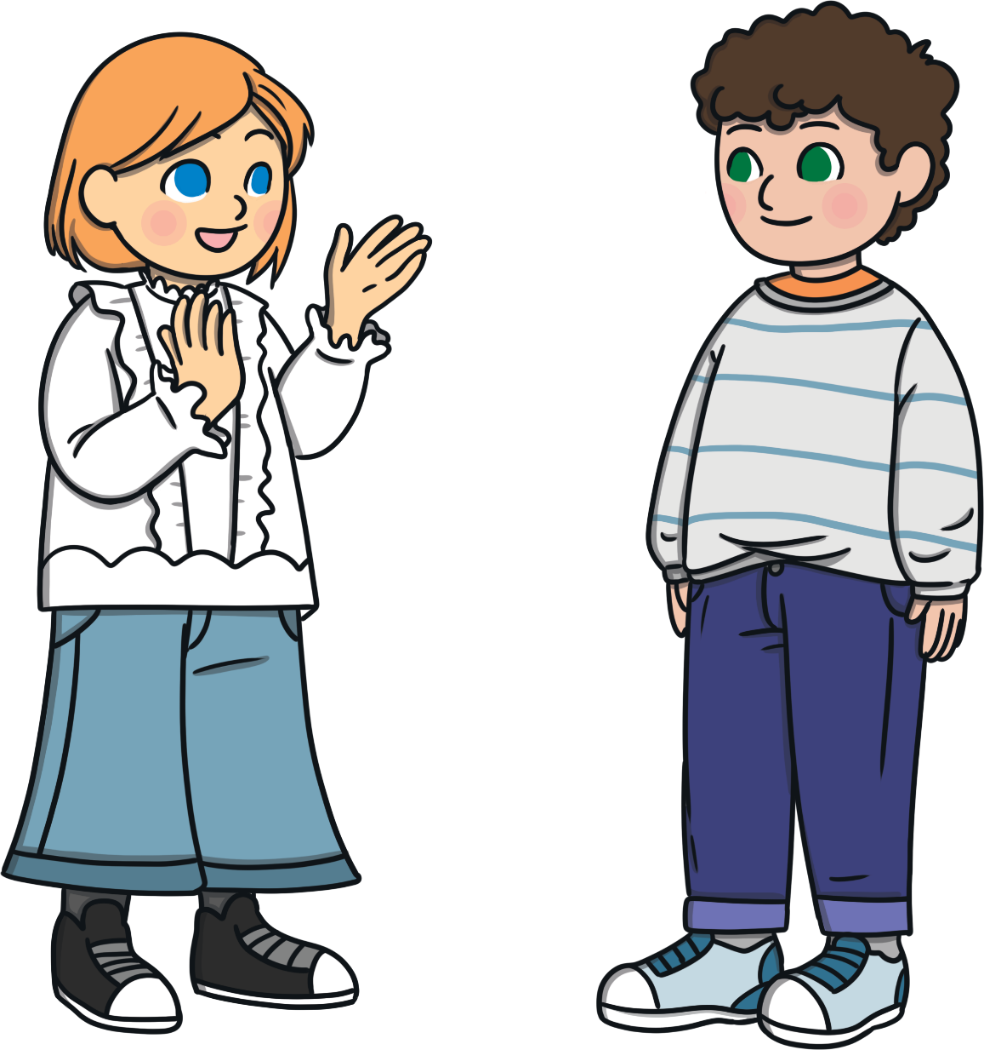
I should tell someone I trust if anyone
asks me to do anything that makes me feel
unhappy or uncomfortable.

Slide 11
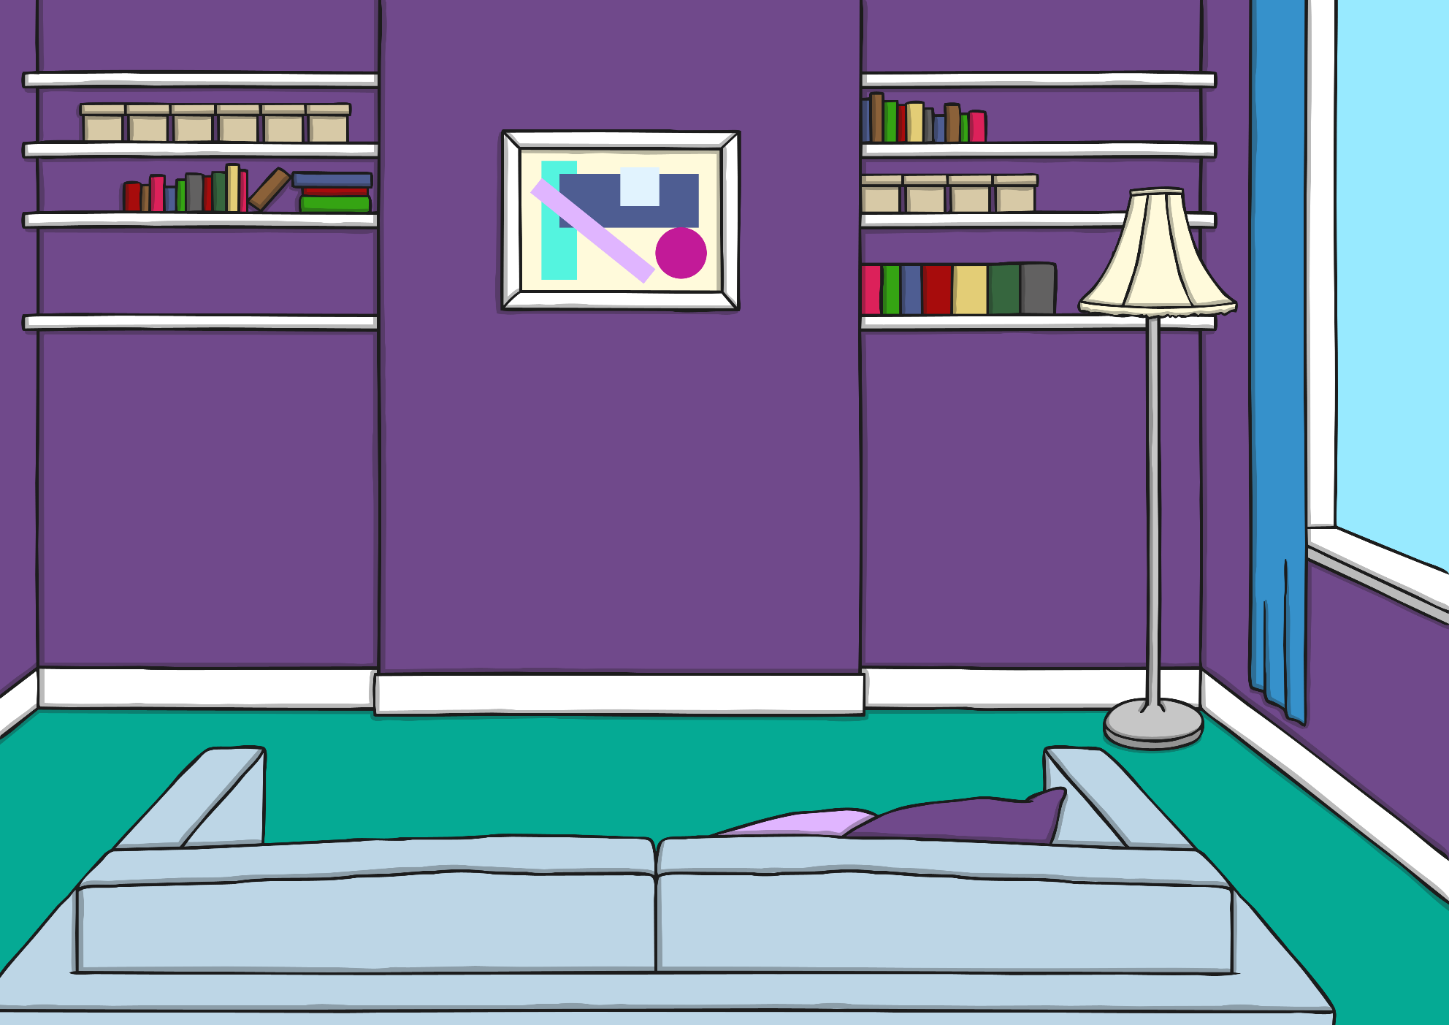
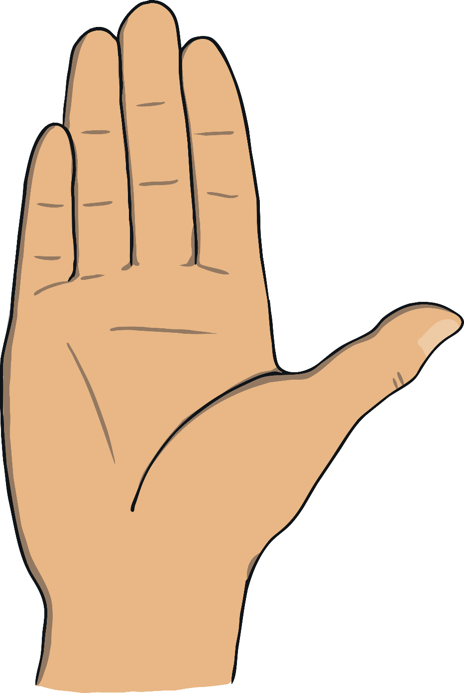
If someone asks me to do something that
makes me feel uncomfortable, such as taking
my clothes off, I should say ‘No’.
No

Slide 12
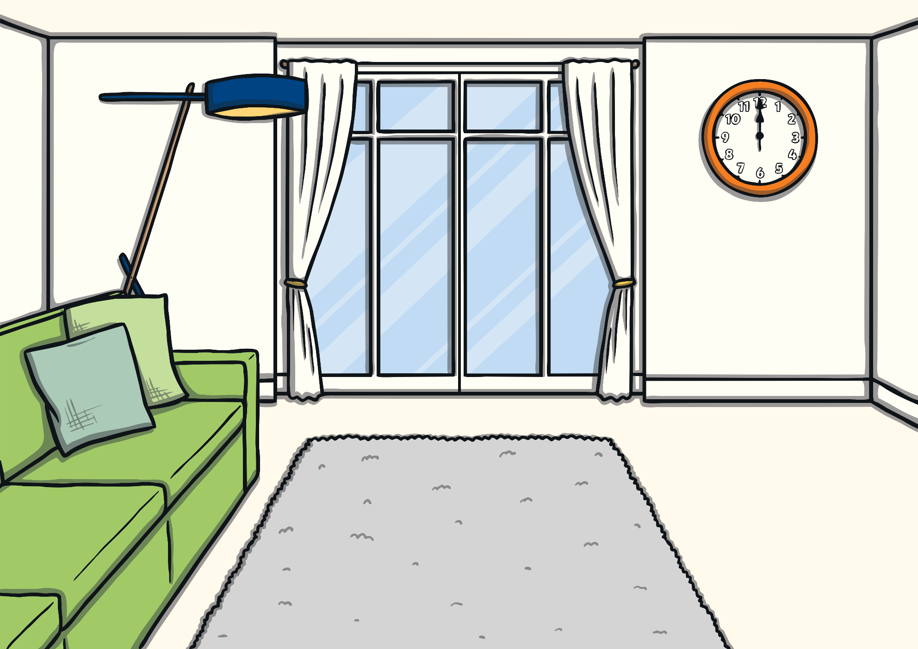
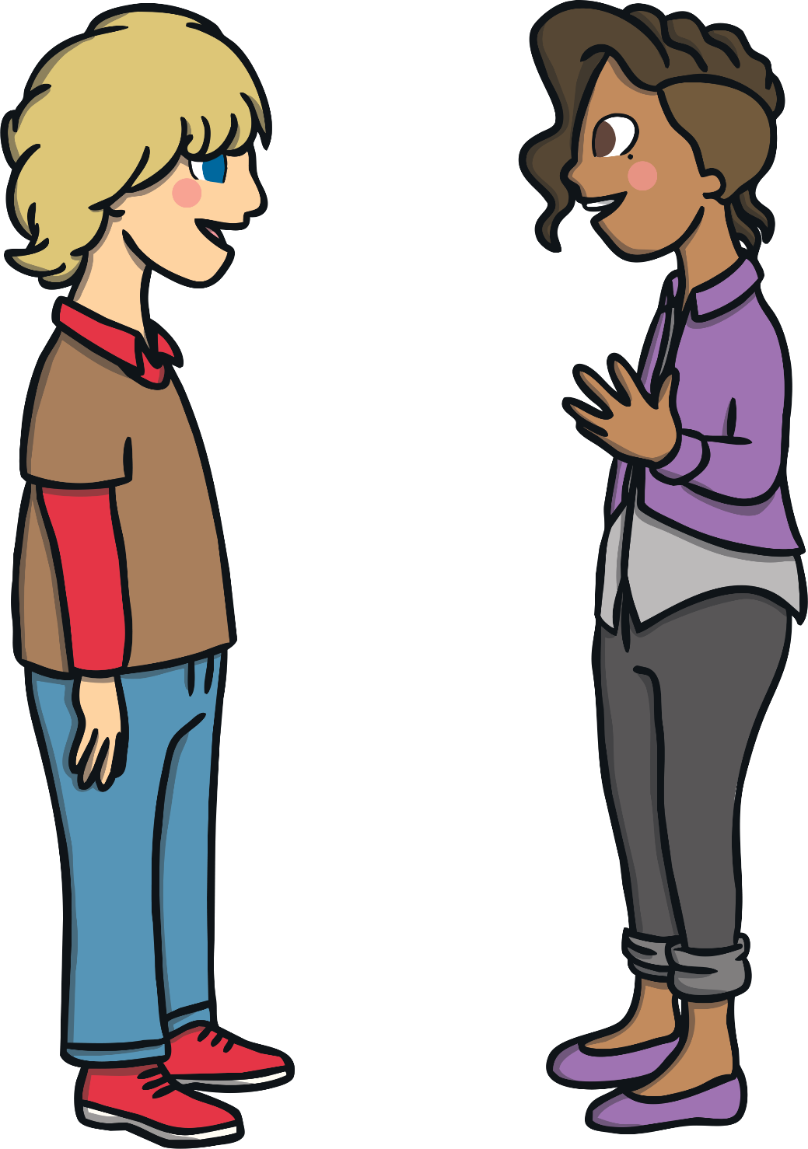
If someone comes into my personal space and
it makes me uncomfortable, I should say ‘No’.

Slide 13
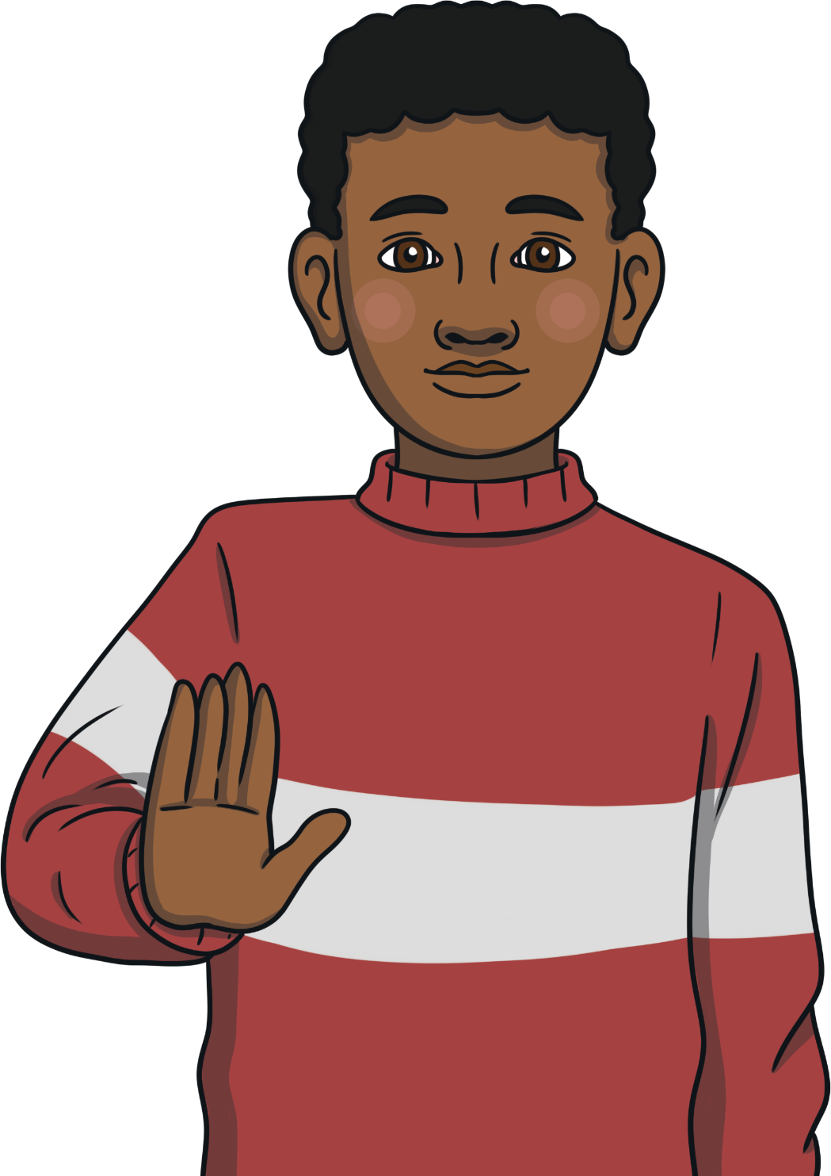
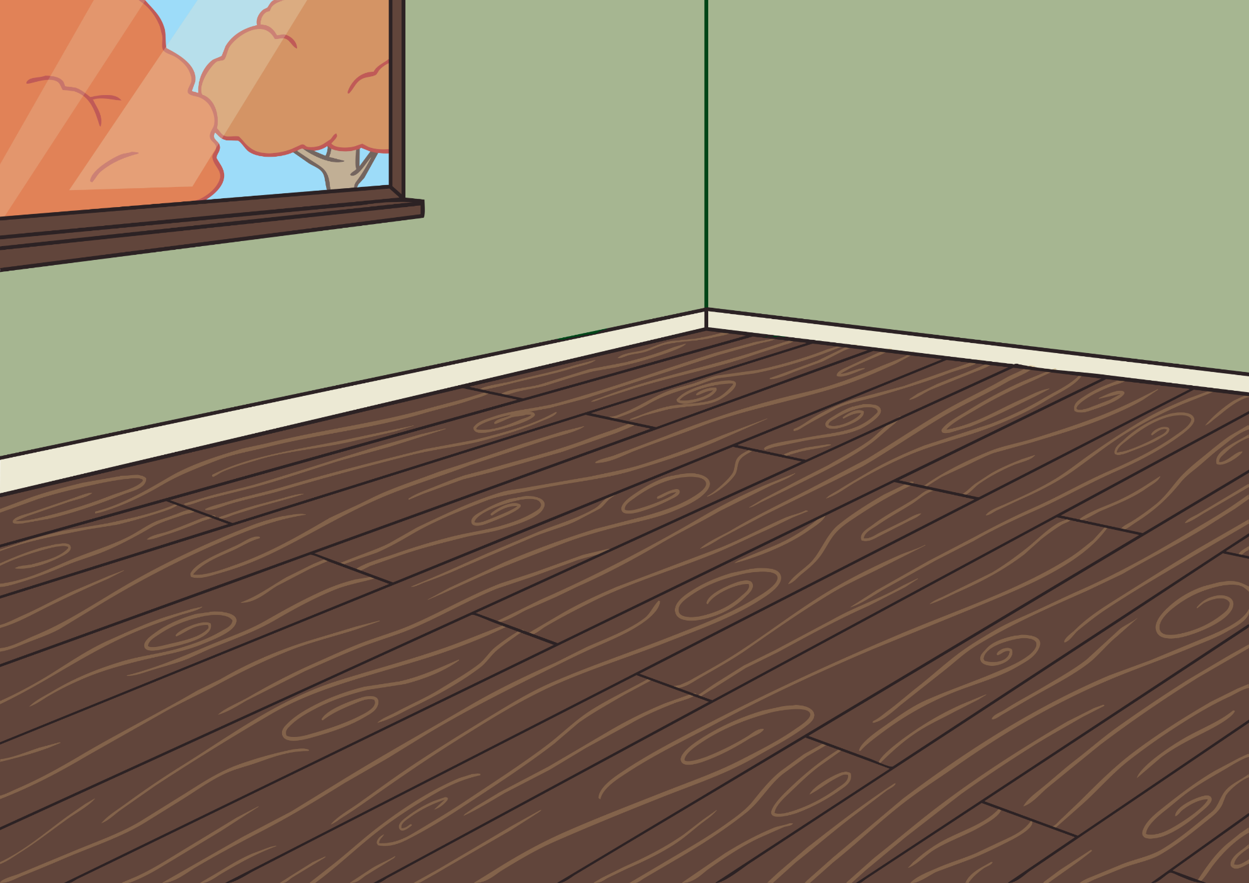
A stranger should never come into my
personal space or touch my body.
I can still say ‘No’ if this makes me feel
uncomfortable.

Slide 14
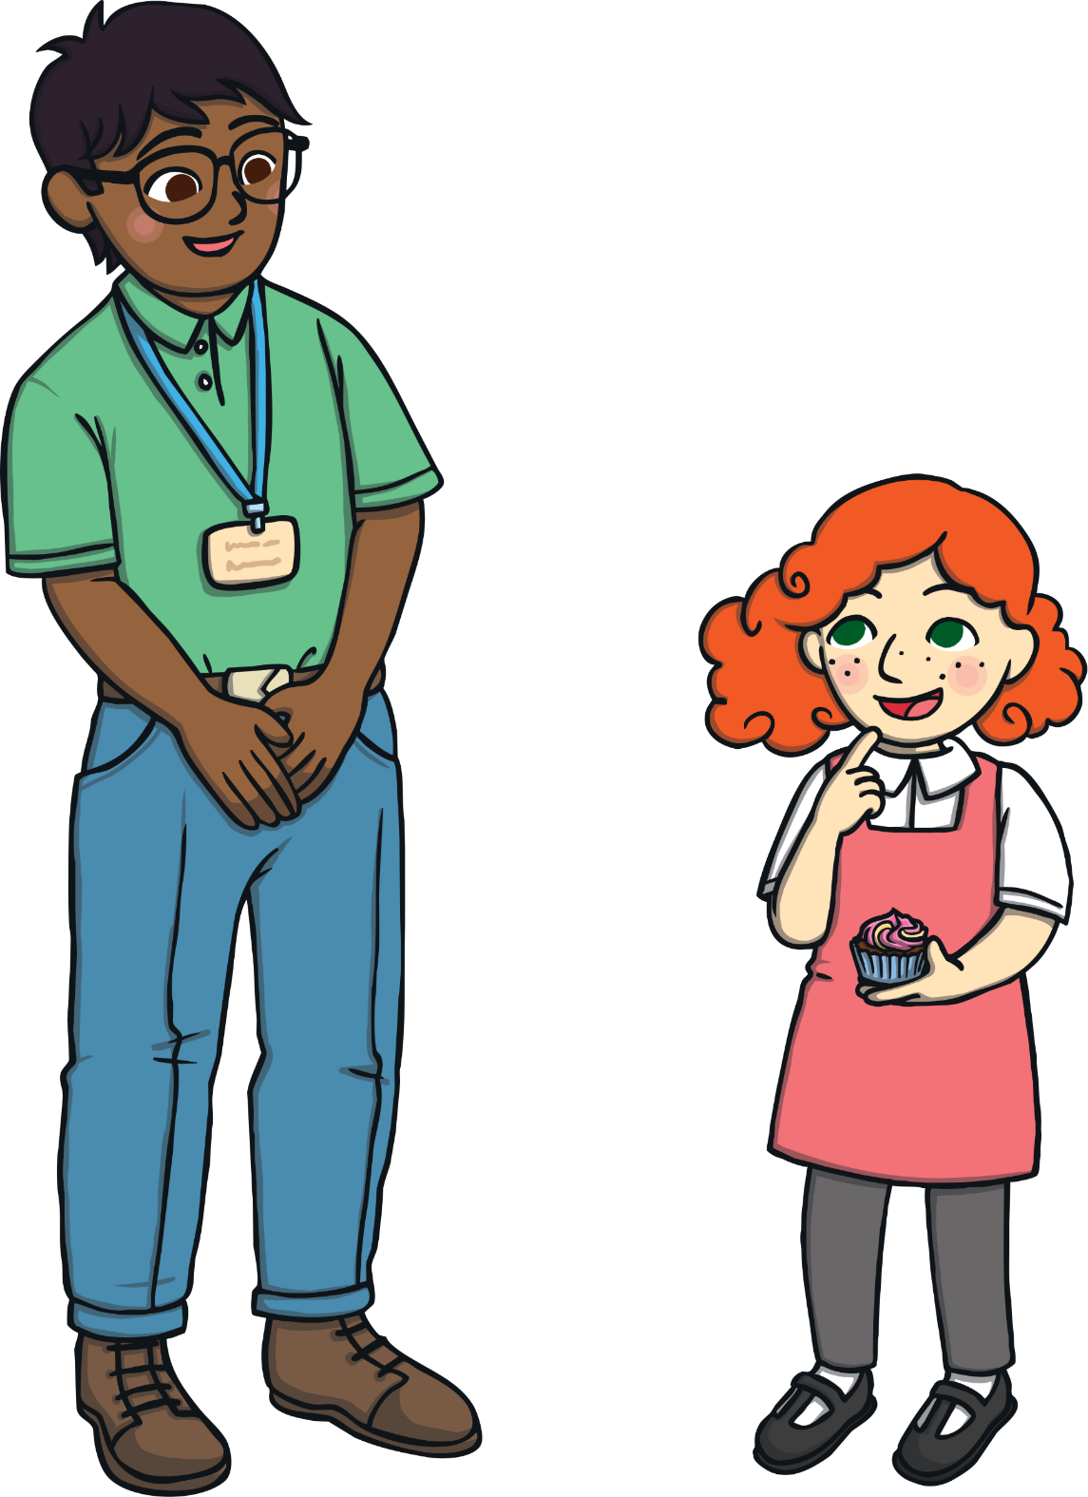
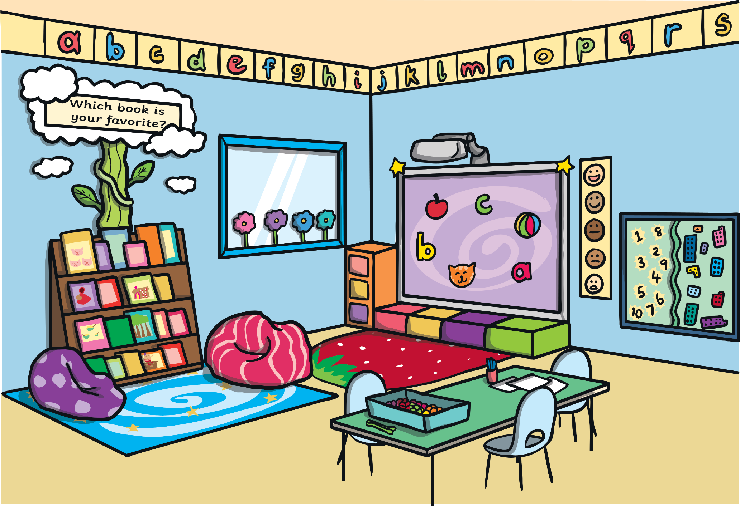
My body is my own.
I decide who comes close to me.
I should always tell an adult I trust if I ever
feel uncomfortable.

